Slide 1


Capstone Project II Predicting individual annual cost of medical insurance by ML method By Lok Hang Ronald, Wong

Slide 2

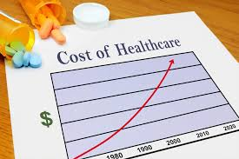
Background Information
Medical cost is one of the largest burdens of Americans
Health care spending per person surpassed $10,000 in 2016
March steadily higher to $14,944 in 2023.
Statistic source from Centers for Medicare and Medicaid Services (CMS)

Slide 3
Aims and Objectives
Establish a ML model for predicting medical insurance cost
Understand essential and non-essential factors for insurance cost
Aid start-up companies to set up better marketing strategy
Aid customers to have better planning on their medical insurance

Slide 4
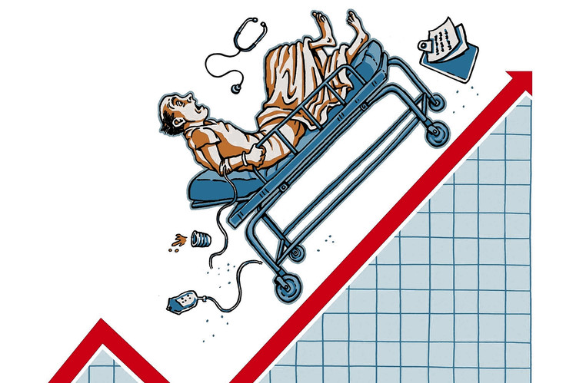

Who might Care?
Start-up Companies
Provide services such as consulting
Finding potential customers
General Public
Evaluation of their current planes
Better planning and strategy
Photo source: http://canonprintermx410.blogspot.com

Slide 5
Dataset
Data source from Kaggle - a subsidiary of Google LLC, is an online community
of data scientists and machine learning practitioners
Contains information of 1337 customers with the following features
(1337 rows, 7 columns)
age: age of primary beneficiary
sex: insurance contractor gender, female, male
bmi: Body mass index, (kg / m²) ideally 18.5 to 24.9
children: Number of children covered by health insurance / Number of dependents
smoker: Smoking
region: the beneficiary's residential area in the US, NE, SE, SW, NW
charges: Individual medical costs billed by health insurance

Slide 6
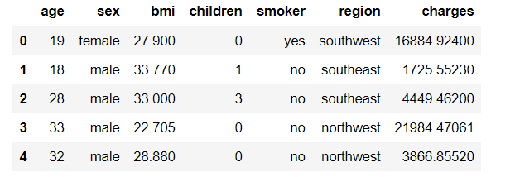
Dataset
Data Preview:

Slide 7
Project Outline
Data Wrangling
-Cleaning Data
-Data Quality Checking
Exploratory Data Analysis (EDA)
-Data Visualization
-Statistical Testing
Pre-processing and Training Data
-One-hot encoding
-Data Splitting
Modeling
-Models Comparison
-Model Features Importance
Conclusion
-Predicting Accuracy
-Other Findings

Slide 8
Exploratory Data Analysis (EDA) – t-test
For comparing categorical variable with numerical variable
For 2 unique values in categorical variable
Null Hypothesis: Mean of two groups are the same
Adopted for gender and smoking behavior

Slide 9
Exploratory Data Analysis (EDA) – One-way ANOVA
For comparing categorical variable with numerical variable
For 3 or more unique values in categorical variable
Null Hypothesis: Mean of all groups are the same
Adopted for region and family size (0 to 5 children)

Slide 10
Exploratory Data Analysis (EDA) – chi-squared test
For checking correlation between categorical variables
Similar with heatmap for numerical variables
Null Hypothesis: The categorical variables are not correlated
Findings: Smoker and Gender, bmi and Gender are correlated

Slide 11
Modelling
2 ML approaches for predicting continuous variable
Ordinary least squares (OLS)
A type of linear least squares method for estimating the unknown continuous variable in a linear regression model
Random Forest Regressor (RFR)
An ensemble learning method for regression operate by constructing a multitude of decision trees

Slide 12
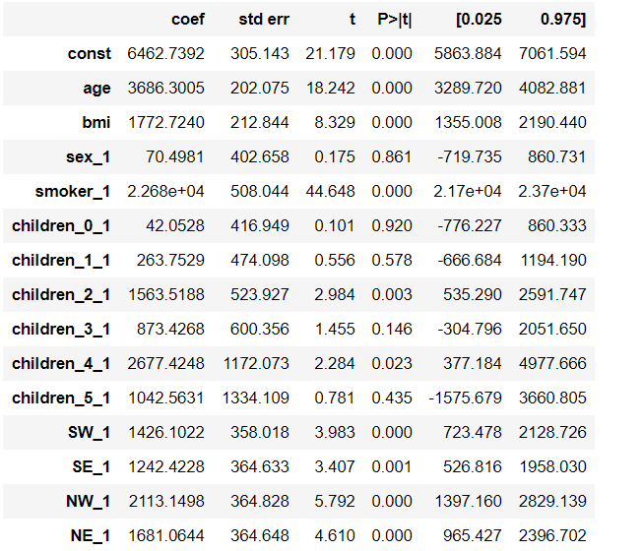
Modelling – Feature Selection
OLS Summary Report

Slide 13
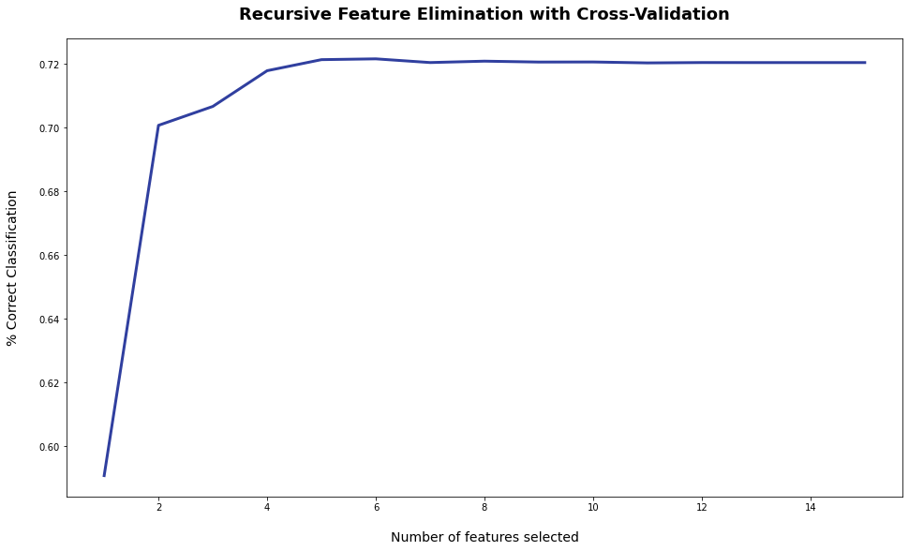
Modelling – Feature Selection
Recursive Feature Elimination and Cross-Validation Selection (RFECV)

Slide 14
Result – Metrics
R2 Score
R2 is a statistic that will give some information about the goodness of
fit of a model. (Best model will have R2 Score:1)
Root Mean Square Error(RMSE)
A frequently used measure of the differences between values (sample or
population values) predicted by a model or an estimator and the
values observed.

Slide 15
Result – OLS Model
Model | R2 Score | RMSE
All Features | 0.786 | 6033
Best 6 Features | 0.643 | 7793
Drop 5 Features | 0.785 | 6042
Best OLS Model

Slide 16
Result – RFR Model
Model | R2 Score | RMSE
All Features | 0.862 | 4840
Best 6 Features | 0.862 | 4844
Best RFR Model

Slide 17
Result –Model Selection
Model | R2 Score | RMSE
Best OLS | 0.785 | 6042
Best RFR | 0.862 | 4844
Selected Model

Slide 18
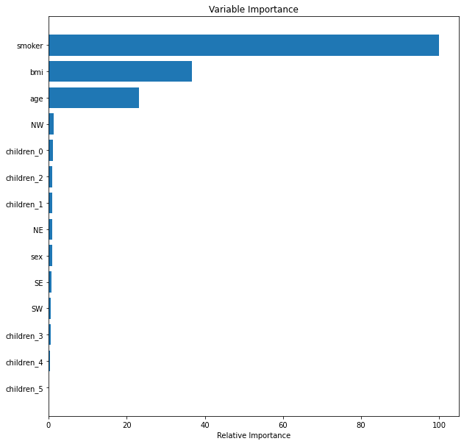
Result –Feature Importance
Adopted in selected model
Not adopted in selected model

Slide 19
Data constraints and limitations
Data size is small (1337 customers)
Only 6 features have been incorporated for prediction
Only 2 regression models have been adopted and compared

Slide 20
Future Studies
Increasing data size to prevent over-fitting
Comprise more customer information (More features can be incorporated such as medical history)
Comparing more ML methods such as K-NN, Neural Network and non-linear model

Slide 21
Conclusion
Established a model for predicting medical insurance cost
Explored important and non-essential factors
Importance to start-up companies and general public

Slide 22
Recommendation
For Start-up companies:
Can provide consultation and prediction service to customers
Can set-up their long-term marketing strategy
Can explore potential customers
For general public:
Can compare current medical insurance with predicted results
Can forecast future insurance cost and set-up better planning (such as changing smoking behavior and target BMI)
Can understand better the features affecting their insurance cost and the features can be ignored

Slide 23
Q & A

